Slide 1
Complements or Substitutes? Firm-Level Management of Labor and Technology
Susan Helper, Case Western Reserve University and MIT
Blue Green Alliance convening
October 2019
Notes:
Thanks to Kauffman and TPRI

Slide 2
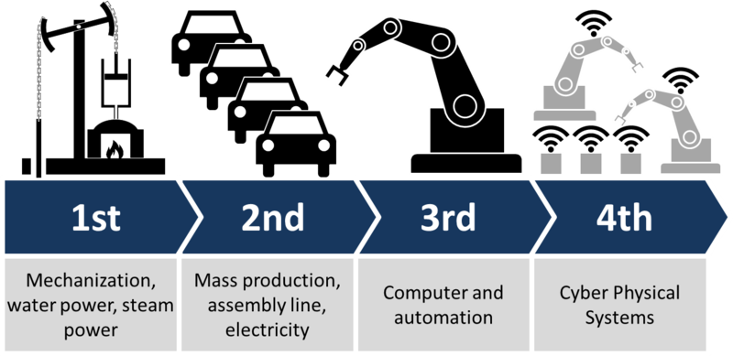
AI and robots in manufacturing: Industry 4.0
The Industry 4.0 Vision:
Continuous collection and analysis of manufacturing data in real-time
Allows managers (both at middle and upper levels) to remotely monitor operations and alter as needed
More dramatically: machines that “think” – that can configure themselves and adapt to changes within the manufacturing process itself
Christoph Roser at AllAboutLean.com

Slide 3
Our study
Research questions:
How do management practices affect impacts of automation and big data on firm performance and wages?
How does use of integrators affect nature of learning and value capture?
Methods:
Three dozen site visits in the auto supply industry between 2017-2019
Auto industry accounts for 40% of robots in use in the US
Data from our survey of tech adoption and use at auto supply firms (N~190; also 2011 survey); multiple questions on robots
Notes:
Adoption; use

Slide 4
Two management “paradigms”
Taylorist: Labor and tech are substitutes
Specialization is valuable; helps separate brain from hand work, planning from execution
Robots are ideal workers: repeatable, reliable, don’t complain or tire
Automation allows engineers’ ideas to be implemented directly, w/o humans
Pragmatist: Labor and tech complement each other
The person closest to production has expertise that no one else has
Big role for learning-by-doing
“machines can’t learn, only people can”
Don’t automate until you have first simplified the production process
→There may or may not be differences in adoption, but likely differences in uses
Notes:
Uses: prag increase quality, not decrease labor; effect on total costs not clear, may be higher or lower.

Slide 5
Two suppliers implementing machine vision
Supplier LP: cameras to check presence of bolts on stamped part Implementation done by 1 engineer, no formal and little informal production-worker involvement
Cameras and software very cheap (<$1000), so positive ROI
However, periodic spikes in defects because no one regularly checked orientation of cameras or monitored data to see if false readings were occurring; no efforts to reduce root causes of mis-orientation
Workers ended up hand-sorting parts to separate good from bad

Slide 6
Using machine vision for inspection
Notes:
What does this look like in practice? In this case from a small auto supplier, the operator is manually using a press to shape a part. In the lower right is a camera that tells her if the part is good to pack in the box. If the part is not good, then the press won’t operate until the problem is fixed. The company may install a robot for this job, but would have to present the parts to the robot one at a time (rather than having a human pick one out of the jumble in the box).

Slide 7
Ford Cleveland Engine Plant
Ford Cle engine plant used cameras + cobots to look for defects in engine quality.
extensive consultation with the UAW before and after implementation, to eliminate false positives.
Production workers added /deepened an improvement task

Slide 8
Lots of adoption of new technologies
Notes:
The robot adoption rate corresponds with recent results from Nancey Green Leigh (She finds ~85% for auto sector firms with 500+ employees).
https://planning.gatech.edu/sites/default/files/pled/

Slide 9
Measures of pragmatism, data-driven decisions
Pragmatism (Prag) measures involvement of production workers in problem-solving and data interpretation:
“see workers as complement to IT” + “diagnose equipment problems” + “use quality assurance data to recommend improvements” + “modify programs on computerized equipment” “meet with customers” + “managers expect them to improve work methods”
Data driven decision making (DDD) measures data practices:
“frequently use data on defects” + “base decisions on data” + “use data to predict downtime” – “intuitive decision-making” – “data is in siloes”

Slide 10
Aside: tasks and occupations
Sig. heterogeneity in tasks done by workers in “same” occupation.
Example: production workers in auto suppliers that focus on assembly of components.
Survey-based measure: (similar results using Burning Glass data)
Value of prag | Percent
0 | 14
1 | 35
2 | 14
3 | 36
4 | 11
total | 100

Slide 11
Pragmatists: robots are complements to shop-floor experience
That is, robots increase the value of those with such experience
Dep vbl: operator compensation | coeff
prag | -1.5207
Robots per wkr | -30.8426*
Prag*robot | 21.38992**
% high school | 0.062001
union | -0.51964
Log plant employment | -1.60298*
multiplant | 3.687688**
_cons | 25.03221***
Obs/R2 | 36/ 0.32
Workers in top
quartile of prag
paid 20% more
than those at
bottom, for
mean robot/wkr
Notes:
No relation between change in robots and wages

Slide 12
Potential takeaways
Firms pursue different management “paradigms” when adopting & using new technologies
“Taylorist” : robots substitute for shopfloor workers
“Pragmatist”: robots complement shopfloor workers
Robots + pragmatism correlated with:
Greater quality improvement compared to robots alone
Higher wages (but not higher costs) compared to robots alone
Public policy can affect these choices
Define new jobs that build on existing skills, have good pay and career ladders
Create mechanisms to use ‘industry 4.0’ data to promote safety, environmental quality

Slide 13
Thank you

Slide 14
Backup slides follow

Slide 15
Robots may improve quality and safety

Slide 16
Robots may also decrease costs

Slide 17
Sample statistics
Variable | Mean | SD | Min | Max
Robots | 0.78 | 0.41 | 0.00 | 1.00
Cobots | 0.26 | 0.44 | 0.00 | 1.00
Automated Parts Tracking | 0.68 | 0.47 | 0.00 | 1.00
Autonomous Guided Vehicles | 0.22 | 0.41 | 0.00 | 1.00
Robots Increase Quality | 0.76 | 0.43 | 0.00 | 1.00
Robots Increase Safety | 0.69 | 0.47 | 0.00 | 1.00
Robots Reduce Labor | 0.58 | 0.50 | 0.00 | 1.00
Robots Reduce Costs | 0.49 | 0.50 | 0.00 | 1.00
DDD Measure | 1.93 | 1.14 | 0.00 | 4.00
Pragmatism Measure | 1.74 | 1.20 | 0.00 | 4.00
Used Integrator | 0.43 | 0.50 | 0.00 | 1.00
Log Employees | 5.49 | 1.17 | 1.39 | 7.86
% Population w/ HS Degree | 0.70 | 0.02 | 0.62 | 0.74
Indiana | 0.13 | 0.34 | 0.00 | 1.00
Kentucky | 0.16 | 0.37 | 0.00 | 1.00
Michigan | 0.31 | 0.47 | 0.00 | 1.00
Ohio | 0.15 | 0.36 | 0.00 | 1.00

Slide 18
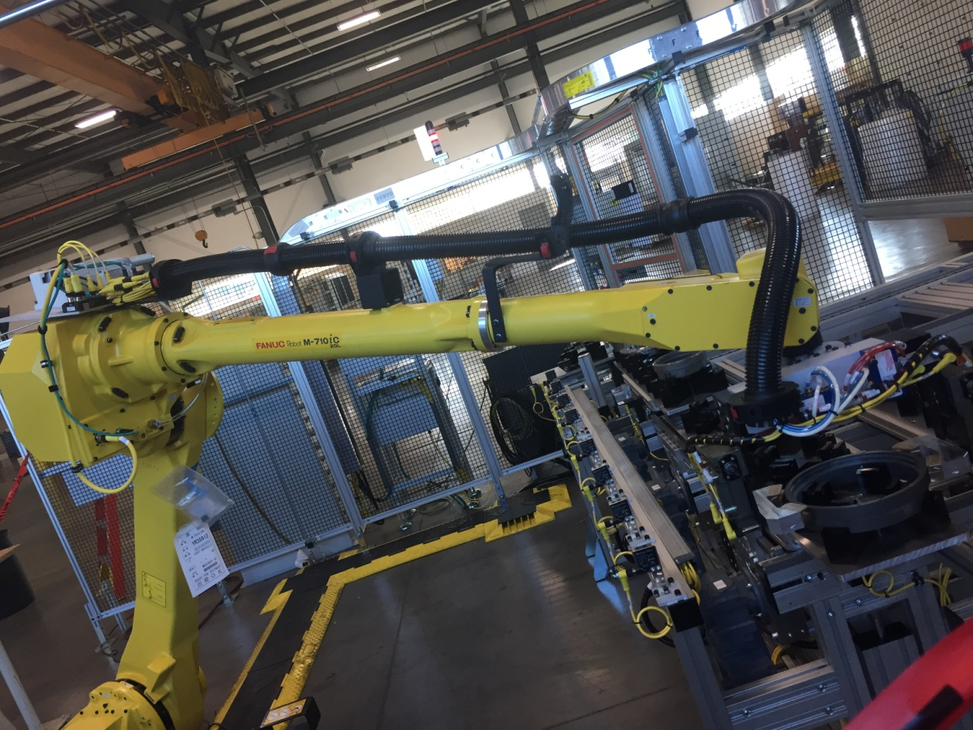
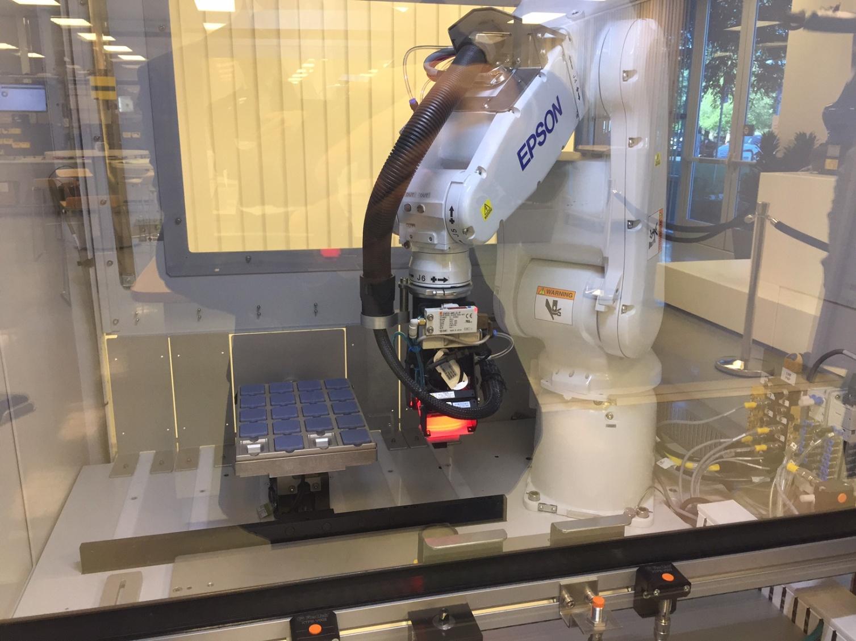
- Large role for integrators
- Lots of customization
Integrators design, assemble a system

Slide 19
Much variation in extent to which plant managers see complementarities between workers and technology
Responses to question: “We have found that use of Information Technology (IT) reduces the need for shop-floor workers to have analytical skill.” (1-Strong Disagree; 5-Strong Agree)
Notes:
Other evidence of complementarities (e.g., Bresnahan, Brynjolfsson, and Hitt 2002; Brynjolfsson and Milgrom 2013)

